Slide 1


Welcome to the Spektrix Patterns Group
Builder Pattern

Slide 2
Agenda
To discuss and improve our understanding of design patterns. Initially we'll follow the 23 week guide covering the Gang of Four Design Patterns laid out by Joshua Kerievsky here - https://www.industriallogic.com/papers/learning.html
Although we'll introduce the Pattern with a code example at the start of the meeting, this is not designed to be a training session, it's intended to be a Study group to consider various questions about the pattern. In doing so we'll benefit from the wisdom of the crowd and hopefully improve our understanding.
Deep knowledge of patterns isn't required, and a diverse range of perspectives is encouraged, but it would be useful preparation if you have studied the pattern that'll be discussed before each session.
1 hour approximately
Introduction to Builder Pattern
Discussion around creational patterns
Look at how we can Implement a Pizza Store using the builder pattern - 20 mins

Slide 3
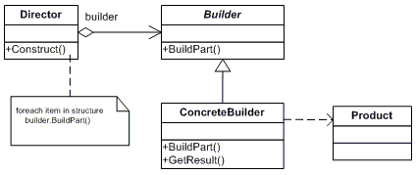
Classic Builder Pattern
“The builder pattern is used to create complex objects with constituent parts that must be created in the same order or using a specific algorithm.
An external class controls the construction algorithm.
The product class defines the type of the complex object that is to be generated by the builder pattern.
The Builder abstract class defines the steps that must be taken in order to correctly create a product. The GetResult method is used to return the final product.
There may be any number of concrete builder classes inheriting from Builder. These classes contain functionality to create a particular complex product.
The director class controls the algorithm that generates the final product object.
Notes:
Other creational design patterns: Builder pattern
Abstract Factory
Singleton
Prototype

Slide 4
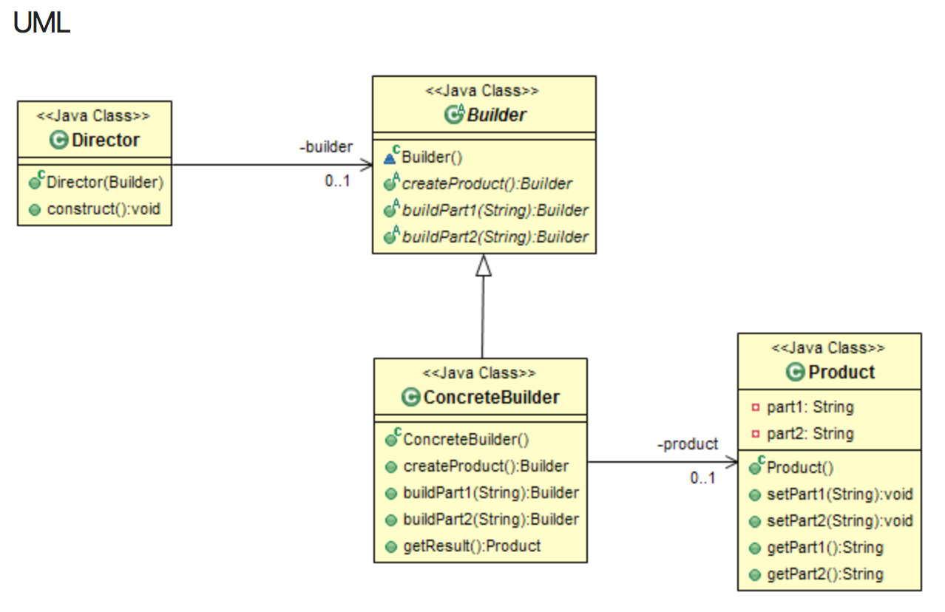
Fluent Builder Pattern
Modifying the Builder interface, so that the steps will return an instance of Builder after each step allows the Director to orchestrate the steps without maintaining a reference to the ConcreteBuilder var product = New Builder() .Step1() .Step2()
.GetResult();
Notes:
Other creational design patterns: Builder pattern
Abstract Factory
Singleton
Prototype

Slide 5
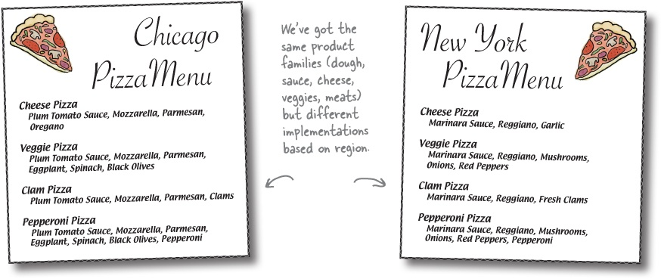
More Pizza
Earlier we used an abstract factory pattern to create different types of pizza from our franchised stores. We can use a builder pattern to allow for a more “Build Your Own” experience, while still maintaining all of the control that the abstract factory pattern provides

Slide 6
Principles covered by this pattern
SOLID Principles:
Single responsibility principle
A class should have only a single responsibility, that is, only changes to one part of the software's specification should be able to affect the specification of the class.
Open–closed principle
"Software entities ... should be open for extension, but closed for modification."
Liskov substitution principle
"Objects in a program should be replaceable with instances of their subtypes without altering the correctness of that program." See also design by contract.
Interface segregation principle
"Many client-specific interfaces are better than one general-purpose interface."
Dependency inversion principle
One should "depend upon abstractions, [not] concretions."
Separate the construction of a complex object from its representation so that the same construction process can create different representations
Reduces complexity that can arise when exposing optional configurations
Which Solid Principles apply to this pattern?
Notes:
Code to an interface(abstraction) not an implementation
Encapsulate what varies - Identify the aspects that vary and separate them from what stays the same. (If Maze, else Bombed Maze else Enchanted Maze) - not “closed for modification.” To extend it with new concrete types, you’ll have to reopen it.
The factory method encapsulates the domain knowledge of how to create the concrete class
Consider the number of dependencies that emerge as the system becomes more complex - (look at the UML)
What if you wanted to create families of products (which we do in the maze game - would a bombed maze have an enchanted wall?)
Dependency Inversion Principle - requires abstracts
It depends on every type of maze element because it actually instantiates concrete types.
No variable should hold a reference to a concrete class.
No class should derive from a concrete class.
No method should override an implemented method of any of its base classes.

Slide 7
Next Session
Let’s talk about… Singleton
Spektrix.GetInstance()

